Slide 1

Credit Card Fraud Detection
Teodorico Pacini, University of Pisa

Slide 2
CREDit card Frauds
Global Fraud Report 2022 ^{[1]}
Nilson Report 2021 ^{[2]}
Survey involved mainly North America and Europe and both SMB, Mid-Market (*) and Enterprise businesses
3.6% of eCommerce revenue lost to payment fraud globally (+0.5% from 2022)
From $180k to $1.8mn for Mid-Market
$28.58 billion lost due to card fraud on a generated volume of $41.96 trillion
Projected an increase of $20 billion in 10 years
[1] https://www.cybersource.com/
[2] https://nilsonreport.com/
(*) $5mn-$50mn of annual revenue

Slide 3
Main steps
Set the goal
Data analysis
Data preprocessing
Classification
Cross validation
Grid search
Classification
Evaluation
Best method and sampling
Best model
Improvement

Slide 4
Goal
Most of the fraud detected (high recall)
Fraud not detected means losing money, losing reputation and customers
At the same time non-fraud detected as fraud means creating troubles to customers and a lot of time consumed investigating them (good precision)
Recall has an higher weight of precision
Find a good tradeoff between performance and classification time (real-time detection)

Slide 5
DAta analysis
Credit Card Fraud Detection
The dataset_{[1]} contains transactions made by credit cards in September 2013 by European cardholders
The transactions occurred in two days
Only numerical input variables
No null values
1081 duplicated fields (removed)
285k samples
31 labels
Time: seconds elapsed from the first transaction in the dataset
Amount: transaction amount
Class
V1-V28, results of a PCA transformation
[1] MLG-ULB dataset: http://www.ulb.ac.be/di/map/adalpozz/data/creditcard.Rdata

Slide 6
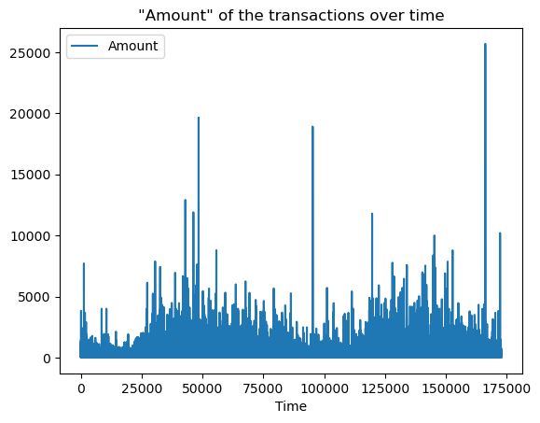
DAta analysis
Credit Card Fraud Detection
Diagram of the transactions over time, for each transaction the Amount is shown on the Y-axis
The Amount goes from 0 to 25k
Most of the transactions are below 10k
Some outliers above 12k
The Time goes from 0 to 175k seconds (namely 48 hours)
Transactions gathered around 12 a.m. - 2 p.m.

Slide 7
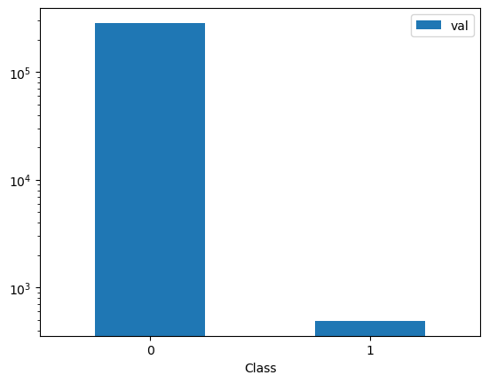
DAta analysis
Credit Card Fraud Detection
Diagram of the class distribution
Dataset is highly unbalanced
492 frauds on 284,807 transactions
0.172% of transactions are frauds
Later we'll use techniques of oversampling and undersampling to improve the classification

Slide 8
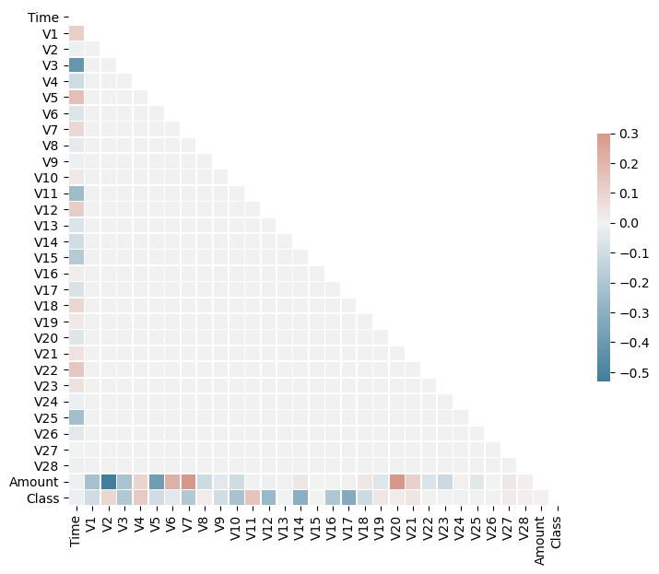
DAta analysis
Credit Card Fraud Detection
Correlation matrix
Little correlation between features
Correlated features:
Amount and V7 (+)
Amount and V20 (+)
Amount and V2 (-)
Time and V3 (-)

Slide 9
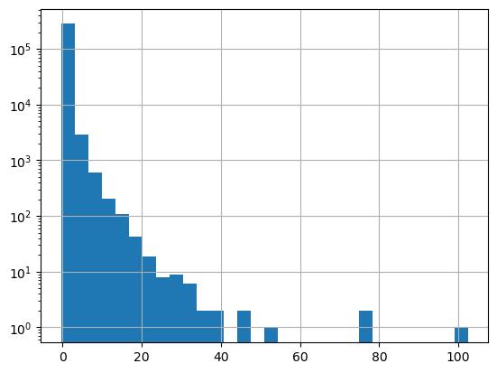
Data pre-processing
Credit Card Fraud Detection
Normalization
Z-score to maintain the same distribution of the data and for robustness towards outliers
Normalization of the "Amount" feature
pre-normalization range: [0, 25000]

Slide 10
Data pre-processing
Credit Card Fraud Detection
Time of the transactions
Recap: the chosen model will be used in real-time detection
The unlabeled data will be gathered after the training data
We need to handle the "Time" feature for training and testing
How do we handle it?
Unchanged
Remove the feature
Fix the value of time (future works)

Slide 11
IMBALANCED DATA
Credit Card Fraud Detection
SMOTE
BorderlineSMOTE _{[1]}
Neighborhood Cleaning Rule _{[2]}
Oversampling
Fix the imbalanced data adding synthetic samples to the minority class
Tendency to link inliers and outliers
Oversampling
Borderline elements will be the one oversampled
Using the default option "borderline-1"
More robust to outliers
Undersampling
ENN to remove noisy samples and 3-NN to remove misclassified elements
Slow, used mostly for data cleaning
In some cases, the removed samples are not sufficient to fix the imbalanced data
[1] H. Han, W. Wen-Yuan, M. Bing-Huan, "Borderline-SMOTE: a new over-sampling method in imbalanced data sets learning", 2005
[2] Laurikkala, J., "Improving Identification of Difficult Small Classes by Balancing Class Distribution, 2001
Notes:
--- BSMOTE ---
Explanation of bsmote
In this case we don't change the default settings, using 'borderline-1' instead of 2 due to the fact that the paper doesn't shows big differences in terms of TP rate and F value among the two
--- NCR ---
More focused on data cleaning than data reduction

Slide 12
MODEL selection
Credit Card Fraud Detection
Logistic Regression
Linear SVM
Decision Tree
Use SGDClassifier*
Suited for numerical attributes
Fast
Use SGDClassifier
Suited for numerical attributes
Fast
Interpretability
Fast in classification
Stochastic Gradient Descent
Notes:
No additional models and sampling methods for time reasons

Slide 13
CROSS VALIDATION
Credit Card Fraud Detection
Done for all the models for each sampling method
For each model, the default parameters have been used
For NCR sampling method a weighted approach has been used, exploiting an additional parameter:
class_weight = {0:1, 1:50}
The cross_validate() function has been used for cross validation
The StratifiedKFold() has been used to create stratified folds, with k=5
The value of k has been chosen considering the time constraint (due to sampling methods)
Goal
Determine on a common baseline the best approach
Handling the "Time" feature
Sampling method
Notes:
Each split is a sampling method execution

Slide 14
RESULTS (CV)
Credit Card Fraud Detection
Removing "Time" feature
"Time" feature unchanged
Name | Accuracy | Recall | Precision | ROC AUC | F2
Logistic Regression (NCR) | 1.00 | 0.86 | 0.44 | 0.98 | 0.71
Linear SVM (NCR) | 1.00 | 0.86 | 0.45 | 0.98 | 0.72
Decision Tree(NCR) | 1.00 | 0.80 | 0.76 | 0.90 | 0.79
Logistic Regression (SMOTE) | 0.97 | 0.90 | 0.06 | 0.97 | 0.23
Linear SVM (SMOTE) | 0.98 | 0.90 | 0.07 | 0.97 | 0.26
Decision Tree(SMOTE) | 1.00 | 0.78 | 0.41 | 0.89 | 0.66
Logistic Regression (BSMOTE) | 0.99 | 0.86 | 0.23 | 0.97 | 0.55
Linear SVM (BSMOTE) | 0.99 | 0.86 | 0.23 | 0.97 | 0.55
Decision Tree(BSMOTE) | 1.00 | 0.73 | 0.72 | 0.86 | 0.72
Name | Accuracy | Recall | Precision | ROC AUC | F2
Logistic Regression (NCR) | 1.00 | 0.84 | 0.45 | 0.98 | 0.71
Linear SVM (NCR) | 1.00 | 0.85 | 0.35 | 0.98 | 0.65
Decision Tree(NCR) | 1.00 | 0.74 | 0.77 | 0.87 | 0.75
Logistic Regression (SMOTE) | 0.97 | 0.90 | 0.06 | 0.97 | 0.25
Linear SVM (SMOTE) | 0.97 | 0.90 | 0.06 | 0.98 | 0.23
Decision Tree(SMOTE) | 1.00 | 0.79 | 0.40 | 0.89 | 0.66
Logistic Regression (BSMOTE) | 0.99 | 0.85 | 0.17 | 0.96 | 0.44
Linear SVM (BSMOTE) | 0.99 | 0.85 | 0.16 | 0.96 | 0.43
Decision Tree(BSMOTE) | 1.00 | 0.77 | 0.65 | 0.88 | 0.74

Slide 15
GRID SEARCH
Credit Card Fraud Detection
Goal
For each model
A RandomizedSearch is performed (10 iterations)
A GridSearch is performed on a narrower range using the result of the first step
Cross validation using the tuned parameters
Determine the best model
Understand if the analysis needs some improvement
Done on the best approach and best sampling method resulting from the cross validation
Notes:
Each split is a sampling method execution

Slide 16
GRID SEARCH
Credit Card Fraud Detection
Linear SVM
Logistic Regression
Decision Tree
alpha: [0.0001, 0.001, 0.01, 0.1, 1]
class_weight: [15, 30, 45, 60, 75, 90]
alpha: [0.0001, 0.001, 0.01, 0.1, 1]
class_weight: [15, 30, 45, 60, 75, 90]
max_depth: [15, 30, 45, 60, 75, 90]
class_weight: [20, 40, 60, 80, 100]
alpha: [0.5, 1, 1.5]
class_weight: [50, 60 ,70]
alpha: [0.5, 1, 1.5]
class_weight: [80, 90, 100]
max_depth: [50, 60, 70]
class_weight: [10, 20, 30]
alpha: 1.5
class_weight: 70
alpha: 0.5
class_weight: 80
max_depth: 70
class_weight: 30
Notes:
Each split is a sampling method execution

Slide 17
RESULTS (CV)
Credit Card Fraud Detection
No grid approach
Name | Accuracy | Recall | Precision | ROC AUC | F2
Logistic Regression (NCR) | 1.00 | 0.86 | 0.44 | 0.98 | 0.71
Linear SVM (NCR) | 1.00 | 0.86 | 0.45 | 0.98 | 0.72
Decision Tree(NCR) | 1.00 | 0.80 | 0.76 | 0.90 | 0.79
Grid approach
Name | Accuracy | Recall | Precision | ROC AUC | F2
Logistic Regression (NCR) | 1.00 | 0.67 | 0.86 | 0.96 | 0.70
Linear SVM (NCR) | 0.99 | 0.60 | 0.15 | 0.79 | 0.34
Decision Tree(NCR) | 1.00 | 0.75 | 0.72 | 0.87 | 0.74

Slide 18
RESULTS
Credit Card Fraud Detection
Classification (d=70, w=30)
Neighborhood Cleaning Rule
Decision Tree
Classification time (84886 samples): 11.8 ms
Confusion Matrix | Accuracy | Recall | Precision | ROC AUC | F2
[84696 48] [ 29 113] | 0.99 | 0.80 | 0.70 | 0.90 | 0.78

Slide 19
Improve classification
Credit Card Fraud Detection
Random Forest
Classification(n=100 , d=70 , cw=60)
RandomizedSearch:
max_depth: [60, 80, 100, 120]
class_weight: [30, 50, 70, 90]
GridSearch:
max_depth: [50, 60, 70]
class_weight: [60, 70, 80]
Classification time: 629 ms
Confusion Matrix | Accuracy | Recall | Precision | ROC AUC | F2
[84729 15] [ 31 111] | 0.99 | 0.78 | 0.88 | 0.89 | 0.80

Slide 20
Conclusions
Credit Card Fraud Detection
Good results even if the dataset was highly unbalanced
Random Forests could be a good alternative to Decision Trees, with the right parameters
The model could be improved (next slide)
Analysis was limited due to computational limits (e.g. GridSearch, Folds in CV, Sampling methods, …)

Slide 21
Further IMPROVEMENTs
Credit Card Fraud Detection
Classification models
Advanced models as XGBoost
Oversampling methods
ADASYN instead of SMOTE
More positive samples to increase the recall
Parameters tuning
Bigger randomized search with more iterations
Increase the number of folds
Integrate additional data

Slide 22
Thank you for your attention!

